Slide 1

Chapter 6. The (Data) Link Layer & LANs
6.4 Switched LANs (Local Area Networks)
Reading for Chapter 6 in the textbook:
Section 6.4
Notes:
In data link layer, we will discuss data link layer design issues, error detection and correction, elementary data link protocols, sliding window protocols, and some example data link protocols.

Slide 2
Outline
Hub, switch and router – What’s the difference?
Addressing at layer 2 and ARP
Ethernet LANs
(Layer 2) Switches

Slide 3


Slide 4
Differences among hub, switch & router
A hub is a layer 1 device that acts on individual bits rather than frames
replaced by switches in early 2000s
A switch is a layer 2 device that is intelligent and can learn the MAC addresses of the devices connected to it
A router is a layer 3 device that can learn the IP addresses of packets
forward packets towards their destination based on their destination IP

Slide 5
Outline
Hub, switch and router – What’s the difference?
Addressing at layer 2 and ARP
Ethernet LANs
(Layer 2) Switches

Slide 6
Addressing at layer 2
Switches
operate at layer 2, and forward link-layer frames (rather than layer 3 packets) to the next node
don’t recognize the IP address of a node
use layer 2 addresses (MAC addresses)
ARP – a layer 2 protocol that maps between IP addresses and MAC addresses

Slide 7
MAC Addresses
A layer-2 address is also called a LAN address, a physical address, or a MAC address
In truth, it is not hosts and routers that have link-layer addresses but rather their adapters that have MAC addresses
A host or router with multiple adapters will thus have multiple MAC addresses associated with it, just as it would also have multiple IP addresses associated with it

Slide 8
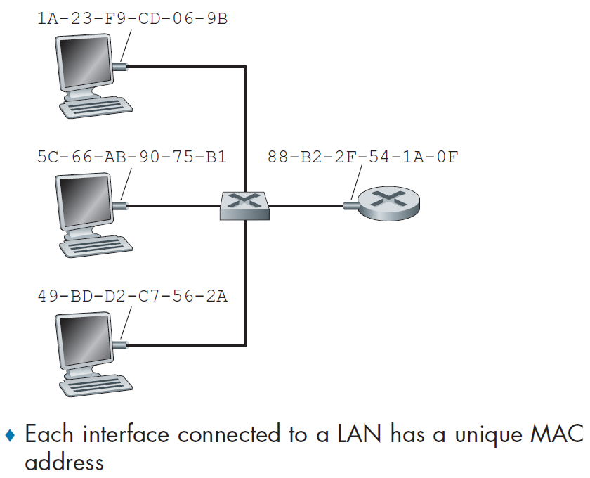

For most LANs, the MAC address is 6 bytes long, with each byte expressed as a pair of hex numbers, each takes 4 bits (0,1,2,...,9,A,B,C,D,E,F)
Switch
Router

Slide 9
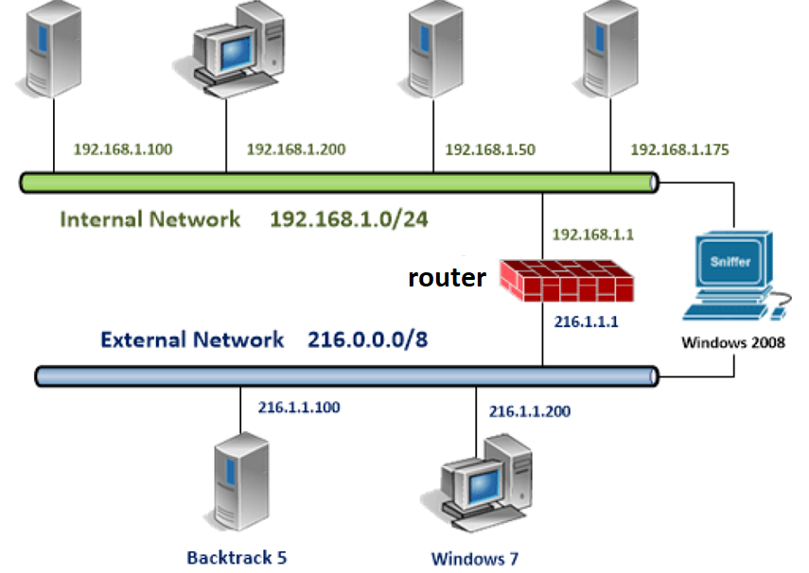


A router with two network interfaces

Slide 10
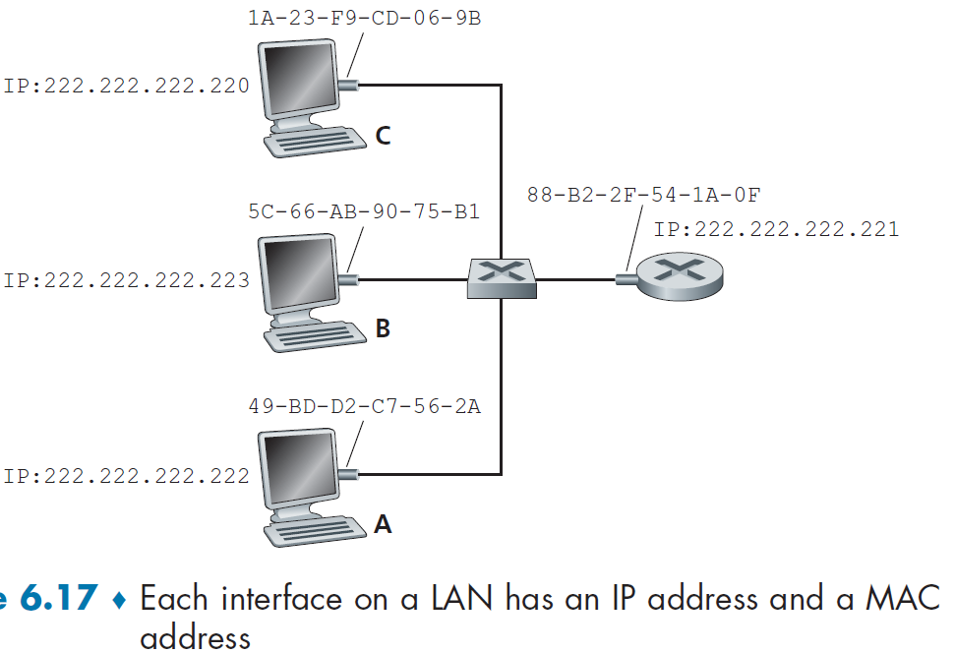
Question: Why is the ARP protocol needed?

Slide 11
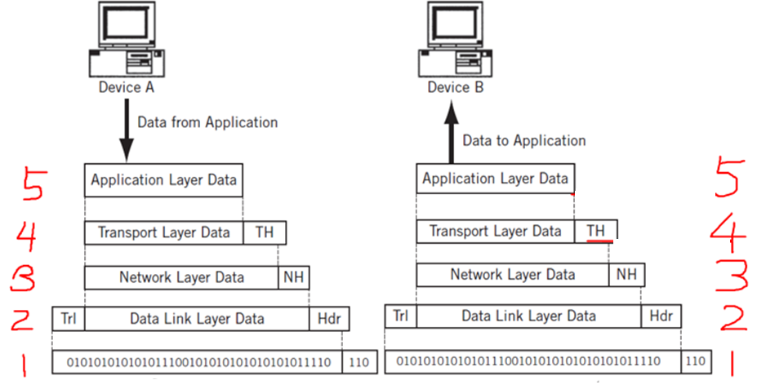
The Need for ARP
Question: How does the sending host determine the MAC address for the destination host?

Slide 12
Outline
Hub, switch and router – What’s the difference?
Addressing at layer 2 and ARP
Ethernet LANs
(Layer 2) Switches

Slide 13
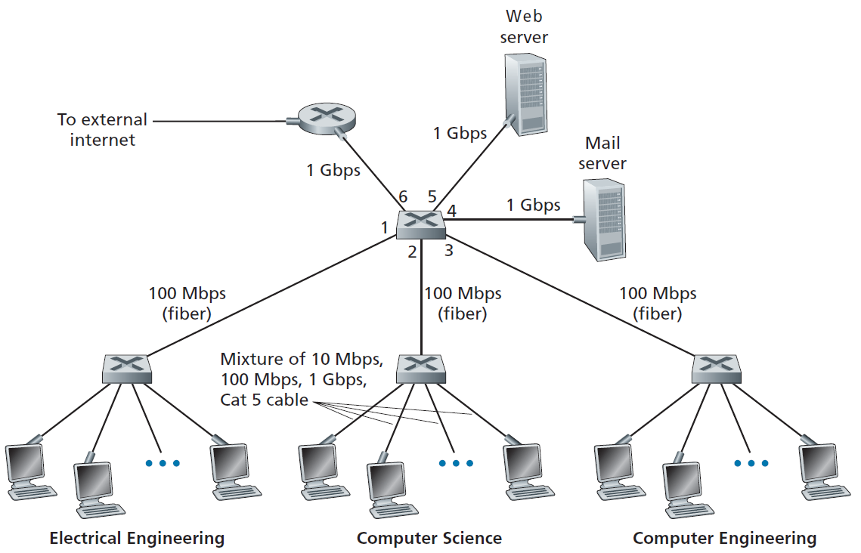


A switched LAN connecting 3 departments, 2 servers and a router with 4 switches

Slide 14
LANs and WANs
LANs (local area networks)
WANs (wide area networks)
Question: Can you give an example of WANs?
A YouTube Video - Differences among LANs, WANs & Subnets
Question: What are the benefits to divide a LAN into subnets?

Slide 15
Ethernet LANs
have continued to evolve and grow since its invention in the mid 1970s
have taken over the wired LAN market today
are by far the most prevalent wired LAN technology, and likely to remain so for the foreseeable future
Efficient (data communication among the hosts an Ethernet LAN)
Low cost (setup & maintenance)

Slide 16
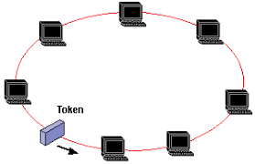
LAN technologies more complex and expensive than Ethernet (1)
(1). A token-ring network is a LAN topology that sends data in one direction throughout a specified number of locations by using a token

Slide 17
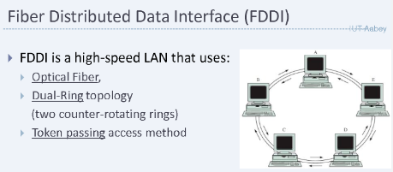
LAN technologies more complex and expensive than Ethernet (2)
(2). Fiber Distributed Data Interface (FDDI) is a network standard that uses fiber optical connections in a token-ring LAN that can extend in range up to 124 miles

Slide 18
Reasons for Ethernet’s Success
Ethernet was the first widely deployed high-speed LAN
Because it was deployed early, network administrators became intimately familiar with it
Other LANs technologies (Token ring, FDDI, etc.) were more complex and expensive than Ethernet
further discouraged network administrators from switching over

Slide 19
Reasons for Ethernet’s Success (2)
Switched Ethernet was introduced in the early 1990s, which further increased its effective data rate and made it more competitive than other LAN technologies
Because Ethernet has been so popular, Ethernet adapters and switches have become a commodity and are remarkably cheap

Slide 20
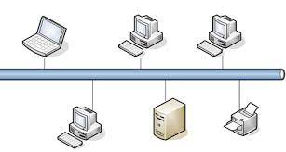
History of Ethernet LANs
From mid-1970s to mid-1990s
In the mid-1970s, the original Ethernet LAN was invented
a coaxial bus was used to interconnect the devices
Bus topologies actually persisted throughout the 1980s and into the mid-1990s
Ethernet with a bus topology is a broadcast LAN
all transmitted frames travel to and are processed by all adapters connected to the bus

Slide 21
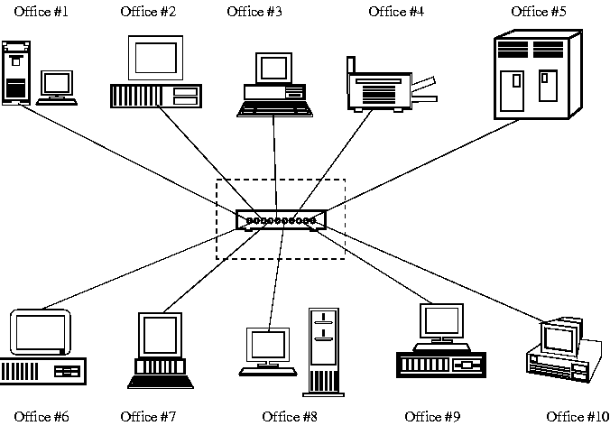
History of Ethernet LANs (2)
By the late 1990s, most organizations had replaced their Ethernet LANs using a hub-based star topology
Ethernet with a hub-based star topology is also a broadcast LAN
hub – layer 1 device

Slide 22

History of Ethernet LANs (3)
In the early 2000s, Ethernet experienced yet another major evolutionary change
Ethernet installations continued to use a star topology, but the hub at the center was replaced by a layer-2 switch
R
S
S
S
S

Slide 23
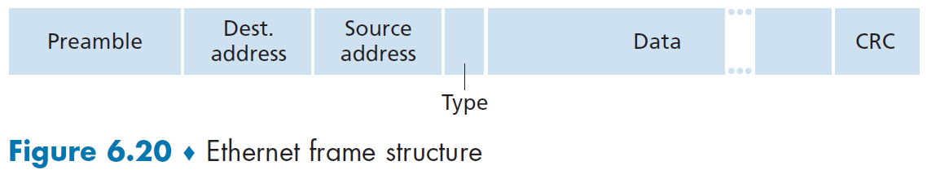
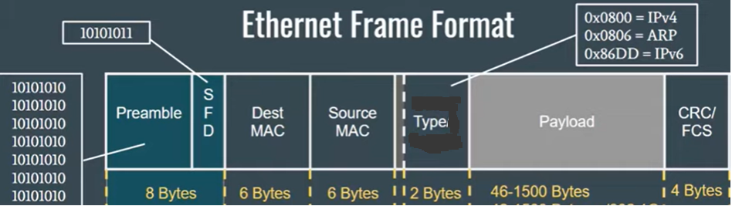

Structures of Layer 2 Header & Trailer
Payload data

Slide 24

Payload Data field (46 to 1,500 bytes)
carries the IP packet with its header
The maximum transmission unit (MTU) of Ethernet is 1,500 bytes
If it exceeds 1,500 bytes, then the host has to fragment the packet
The minimum size of the data field is 46 bytes

Slide 25

Source MAC
Destination MAC
CRC: used by a receiver for error detection
Type: permits Ethernet to multiplex network-layer protocols (in hex)
Notes:
Physical layer errors are Frame Check Sequence (FCS) which by far are the most common source of CRC errors causing many to believe they are one and the same

Slide 26

Preamble field (8 bytes)
The first 7 bytes of the preamble serve to
“wake up” the receiving adapters and
synchronize their clocks to the sender’s clock
A receiving adapter can lock onto sender adapter’s clock simply by locking onto the bits in the first 7 bytes of the preamble

Slide 27

SFD: Start of Frame Delimiter
The 8th byte of the preamble
the first field of an Ethernet frame
indicates the beginning of the Ethernet frame
designed to break the bit pattern of the preamble and signal the start of the actual frame

Slide 28
Outline
Hub, switch and router – What’s the difference?
Addressing at layer 2 and ARP
Ethernet LANs
(Layer 2) Switches

Slide 29
Layer 2 Switches
What does a switch actually do? What is the role of switches in an Ethernet LAN?
How does a switch work?

Slide 30
Layer 2 Switches (2)
The role of a switch is to receive incoming layer-2 frames and forward them onto outgoing links
Switch functions include
Filtering - determines whether a frame should be forwarded (to some interface) or dropped
Forwarding - determines the interfaces to which a frame should be directed, and then moves it to those interfaces
Switch filtering and forwarding are based on the switch table

Slide 31
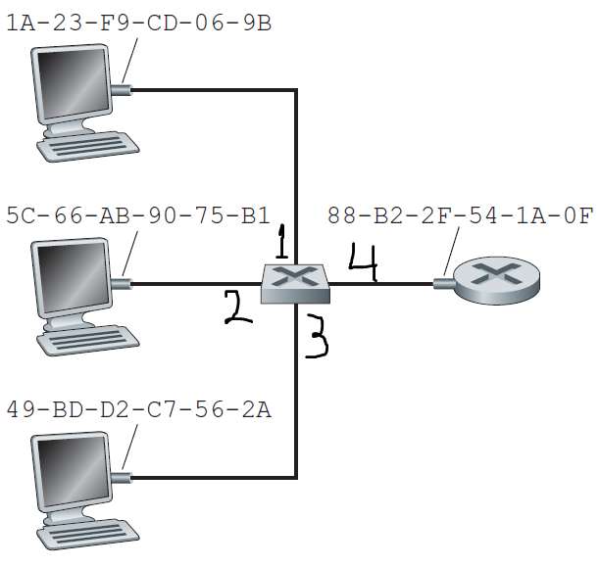

MAC address | Interface | Time
1A-23-F9-CD-06-9B | 1 | 9:32
5C-66-AB-90-75-B1 | 2 | 9:34
49-BD-D2-C7-56-2A | 3 | 9:37
88-B2-2F-54-1A-0F | 4 | 10:13
MAC address
The switch interface that leads toward that MAC address
The time at which the entry was placed in the table

Slide 32
Switch Self-Learning - A switch table is built automatically, dynamically, and autonomously
The switch table is initially empty
For each incoming frame received on an interface of the switch, the following information is stored in its switch table
its source MAC address of the frame
the interface from which the frame arrived, and
the current time

Slide 33
Switch Self-Learning - A switch table is built automatically, dynamically, and autonomously
If every host in the LAN eventually sends a frame, then every host’s MAC address will eventually get recorded in the switch table
An MAC address is deleted from the table if no frames are received from that MAC address after some period of time (the aging time)
Therefore, if a PC is replaced by another PC (with a different adapter), the MAC address of the original PC will eventually be deleted from the switch table

Slide 34
Switches are plug-and-play devices
Switches require no intervention from a network administrator or user
A network administrator
needs to do nothing but connect a LAN segment to a switch interface
need not configure the switch tables at the time of installation or when a host is removed from the LAN
Switches are also full-duplex (any switch interface can send and receive at the same time)

Slide 35
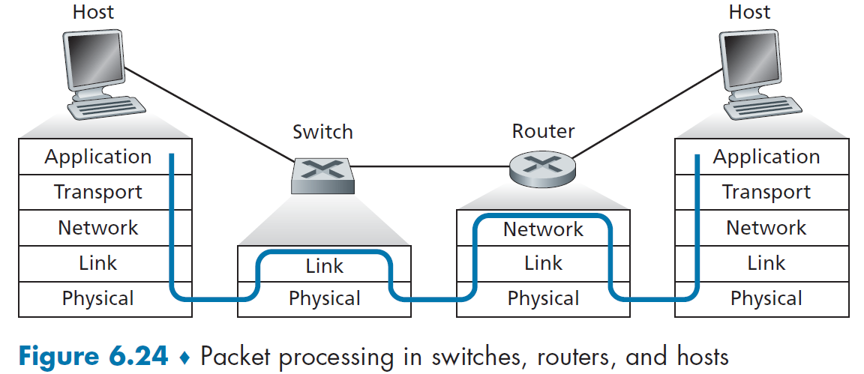
Layer-2 Switches process and transmit frames only up through layer 2
Routers have to process packets up through layer 3
Hosts have to implement the functions at all the five layers

Slide 36
Some Issues with Layer-3 Routers
Have to implement all the layer-3 networking functions
Routing: forward packets to their destination IP
Addressing: inspect the IP network-prefix addresses of incoming packets
Internetworking: Routers connect devices to different IP networks
Congestion control: help manage network congestion
Error handling: help handle errors on the network
Low throughput, low port density, and low traffic management speed due to limited system resources
Much more expensive than layer-2 switches

Slide 37
Layer-3 Switches
Not covered in the textbook (2020)
Layer-2 switches (review)
are traditional network switch ports that operate in layer 2
forward frames based on their MAC addresses
use the address resolution protocol (ARP) tables to enable network communication

Slide 38
Layer-3 Switches (2)
Layer 3 switches
also known as multi-layer switches
operate in layer 3 (network layer)
are able to learn IP addresses of packets
forward packets based on the IP address of the source and destination hosts
can perform all the functionalities of a layer-2 switch along as well as routing in layer 3

Slide 39
Layer-3 Switches (3)
Layer 3 switches
can operate on both layer 2 and layer 3, and forwards packets based on its IP routing table along with ARP tables
only includes basic routing functionality, but do not have all the features at layer 3
Question: Should I use a layer 3 switch or a router?

Slide 40
 | Layer 3 Switches | Routers
System resources | Less | More
Software features | Less | More
Networks supported | LANs, and subnets ONLY | LANs, subnets, and WANs
Throughputs and traffic speed | High throughput, high port density, and high traffic speed is enabled by layer 3 switches' hardware configurations and the ability to combine switching and routing capabilities | Typically use software-based routing, which can be slower but offers more advanced routing. Low throughput, low port density, and low traffic management speed when compared to layer 3 switches
Cost | Comparatively low cost | Comparatively high cost

Slide 41
Review Questions (1)
What is a hub? Why a packet sent from any computer connected to a hub will reach all the computers connected to the hub?
What is a switch? Why a packet sent from a host connected to a switch will only reach the intended receiving host connected to the switch? What is the Mac address table of a switch used for?
What is the difference and similarity between a hub and a switch?
What is a router? How two hosts in different networks communicate with each other through routers? What is the difference between a router and a bridge? Is a router layer 2 or layer 3 device?
Notes:
Let’s look at Wireless LANs.

Slide 42
Review Questions (2)
How does a sending host of a packet determine the MAC address of its destination host in computer networking?
What is the length of a MAC address?
What are the differences between a router and a switch?
What are the differences between a hub and a switch?
Can a switched LAN directly connect to other networks on the Internet through a switch without using a router?
What is a layer-3 switch? What are the advantages of using a layer-3 switch over a router?
Notes:
Let’s look at Wireless LANs.

